Slide 1
Software Fault Prediction using Machine Learning Models
Naveen Syamala & Yasaswini Kandru

Slide 2
Software Fault Prediction
Automatically identify fault prone modules in the software before system testing.
Why is it important to perform SFP?
Notes:
software fault prediction to identify faulty software modules early in the development life cycle has gained considerable attention over the last two decades.

Slide 3
Advantages of SFP
Reduce testing duration
Reduce cost of resources and infrastructure
Increase Software quality
Notes:
A software company needs to deliver a finished product while it has limited time and budget for testing it. In such cases, identifying and testing parts of the system that are more defect prone is reasonable

Slide 4
Machine Learning Models
Linear Regression
Random Forest
Naive Bayes
Support Vector Machine
Decision Tree
Notes:
It is typically performed by training a prediction model using project properties augmented with fault information for a known project, and subsequently using the prediction model to predict faults for unknown projects. It is totally based on the understanding that if a project developed in an environment leads to faults, then any module developed in the similar environment with similar project characteristics will ends to be faulty

Slide 5
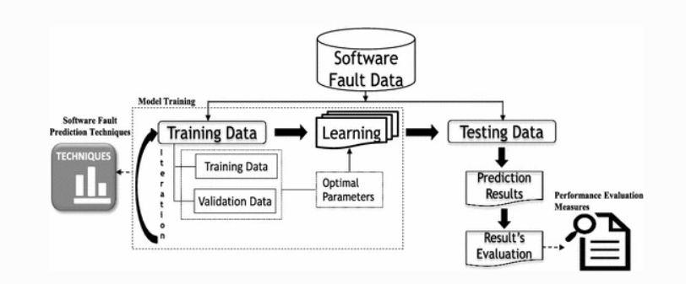
SFP using ML model
Notes:
The figure depicts the three important components of software fault prediction process are: Software fault dataset, software fault prediction techniques, and performance evaluation measures.
First, software fault data is collected from software project repositories containing data related to the development cycle of the software project such as source code and change logs, and the fault information is collected from the corresponding fault repositories.
Next, values of various software metrics (e.g., LOC, Cyclomatic Complexity etc.) are extracted, which works as independent variables and the required fault information with respect to the fault prediction (e.g., the number of faults, faulty and non-faulty) work as the dependent variable.
Finally, the performance of the built fault prediction model is evaluated using different performance evaluation measures such as accuracy, precision, recall, and AUC (Area Under the Curve).

Slide 6
Software Metrics For SFP
Static code metrics
Lines of Code, Cyclomatic Complexity Number
Object oriented metrics
Coupling Between Objects, Number of Children
Process metrics
Number of Defects in Previous Version, Number of Modified lines
Notes:
Excessive software metrics during software development life cycle often collected for different reasons and stored in software project repositories. And selection of software metrics is another critical point to build a software defect prediction model.
Static code metrics can be directly extracted from source code, such as Lines of Code (LOC), Cyclomatic Complexity Number (CCN),
Object oriented metrics is a subcategory of static code metrics. Import coupling metrics are strongly associated with fault proneness and predict faulty classes with high accuracy in object oriented system.
Process metrics can be extracted from Source Code Management system based on historic changes on source code overtime.

Slide 7
Software defect prediction using Random Forest Algorithm

Slide 8
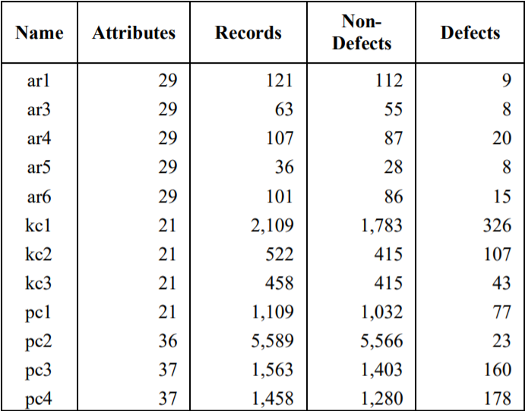
Dataset
tera-PROMISE dataset
Categorized into AR, KC and PC datasets
Notes:
This dataset is created by NASA metrics data program and is publicly available to apply predictive models in SE.
The PROMISE dataset is categorized into 3 groups namely AR, KC, PC datasets. It includes function level static code attributes and defect information like whether there is a bug or not.
AC datasets are from a software implemented in C by Turkish white-goods manufacturer.
KC dataset is from storage management and is implemented in C++.
PC dataset are from flight s/w for earth orbiting satellite and are C functions.

Slide 9
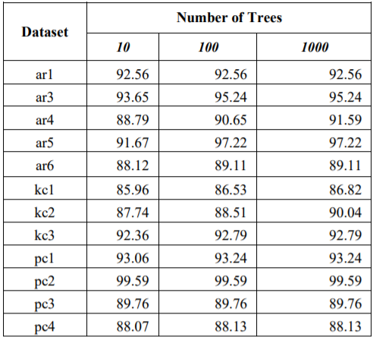
Key Points
Maximum accuracy of prediction with RF is 99.5
Minimum accuracy of prediction is 85.9
Accuracy of RF will increase with the number of trees in the algorithm.
Notes:
Tested the model with increasing the number of trees in random forest algorithm.

Slide 10
Experimental study on Software Fault Prediction using Machine Learning model.
Notes:
This is a classification problem where the model decides whether the module is faulty or not

Slide 11
Key Points
They have used tera-PROMISE dataset.
Identified the accuracy, precision, recall, F-measure, AUC for each technique.
Analyzed the results and determined which technique is effective for fault prediction.

Slide 12
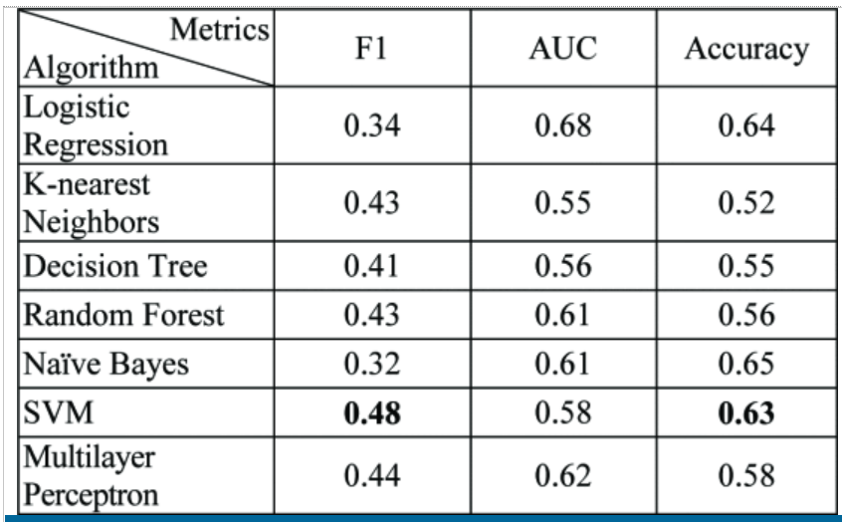
Class Level fault prediction

Slide 13
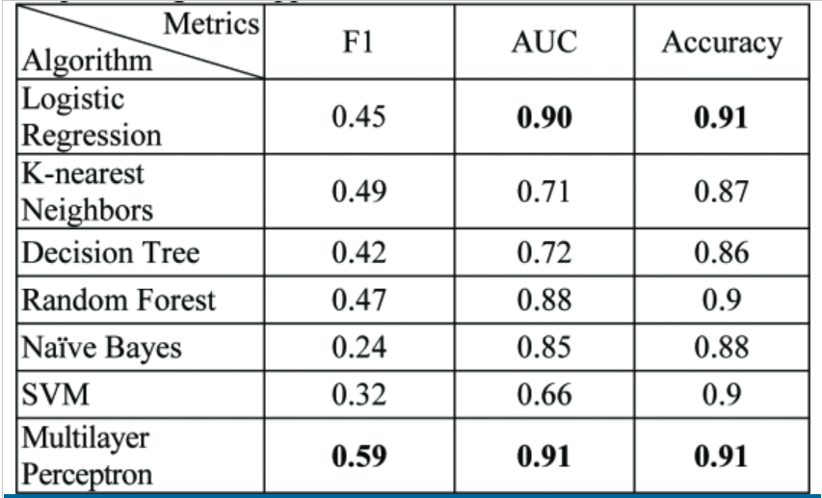
Method-level fault prediction

Slide 14
Question?
Is it possible to develop a hybrid model?

Slide 15
Software Defect Prediction Using Machine Learning Techniques
Notes:
SFP is now a significant research field thereby numerous strategies have been explored to somehow enhance the efficiency of detecting software defects or predicting bugs.
Classification is performed

Slide 16
Key Points
KC1, PC3, CM1 from Promise Dataset
Used PCA with SVM, Naive Bayes, Random Forest
Dealt with the issue of classification accuracy for massive datasets
Notes:
PCA model for feature extraction and dimensionality reduction of the dataset without information loss.
Input data play an important task in categorizing and predicting results.
The advantage of the proposed approach is that the feature collection methodology recognizes and selects the data set's most important functionality for learning purposes, the features are utilized more in predicting. The complexity in the information is reduced and the efficiency of the learning method can be enhanced.
By designing a new hybrid model using feature reductions and classification, dealt with the issue of classification accuracy for massive datasets.

Slide 17
Evaluation
Dataset | SVM | Random Forest | Naïve Bayes
KC1 | 1.00 | 0.99 | 0.96
CM1 | 0.99 | 0.98 | 0.97
PC4 | 0.96 | 0.98 | 1.00
MW1 | 1.00 | 0.97 | 0.99
PC3 | 0.97 | 1.00 | 0.98
Notes:
The model learns from training dataset and then we predict the classification of s/w module for test dataset. Accuracy gives how perfectly the model has predicted the classification. Here you see that the Acc values in the table for different categories of the dataset and for different algorithms.

Slide 18
Software Defects Prediction using Machine Learning Algorithms
Notes:
IEEE Paper published in 2020. This paper performed regression models to predict the no. of defects in the software module.
ANN, RF, Decision Tree, Linear Regression, Gaussian Processes, SMOreg and M5P are used
KC1 data has two categories - class level defects count, class level defective or not. Uses class level data (defects count data) for KC1 from NASA PROMISE repository
SMOreg implements the support vector machine for regression. The parameters can be learned using various algorithms. The algorithm is selected by setting the RegOptimizer.
M5 model tree is a decision tree learner for regression task which is used to predict values of numerical response variable Y, which is a binary decision tree having linear regression functions at the terminal (leaf) nodes.

Slide 19
Software Metrics
PERCENT_PUB_DATA
Percentage of data that is public and protected in a class
ACCESS_TO_PUB_DATA
The number of times that a class’s public/protected data is accessed
COUPLING BETWEEN OBJECTS
The number of non-inheritance related classes on which a specific class depends
DEPTH
The level for a class
Notes:
Class level attributes are used in this experiment.
NUMDEFECTS represent the number of recorded class defects and is used as response variable that is used by ML models in the prediction process.
Access to PUB data represent ensapsulation. Lower values indicate greater encapsulation

Slide 20
Software Metrics
NUM_OF_CHILDREN
The number of classes derived from a specific class
DEP_ON_CHILD
Whether a class is dependent on a child class or not
FAN_IN
Number of calls by higher modules
LACK_OF_COHESION_OF_METHODS
The percentage of methods that uses a datafield in a class

Slide 21
Software Metrics
RESPONSE_FOR_CLASS
Count of methods implemented in a class + count of methods accessible for a class due to inheritance
WEIGHTED_METHODS_PER_CLASS
The count of methods implemented within a class
NUMDEFECTS
No.of defects
Notes:
RESPONSE for class and weighted methods represent polymorphism. So lower values include greater polymorphism

Slide 22

Metrics For Evaluation
Notes:
These metrics measure the error rate between the number of actual defects and number of predicted defects in the dataset.
R2 gives ow much actual and predicted values are related. Value ranges between [-1,1]. I means +linear relation, 0 means no relation and -1 is - linear relation
MAE is the average of the difference between actual and predicted values.
RMSE is more like MAE but RMSE represents the square’s average of difference between the actual and predicted values. The focus is more on significant errors than on small errors.
RAE gives the average of actual values i.e the absolute error
RRSE is the average of actual values but the error is the total squared error

Slide 23
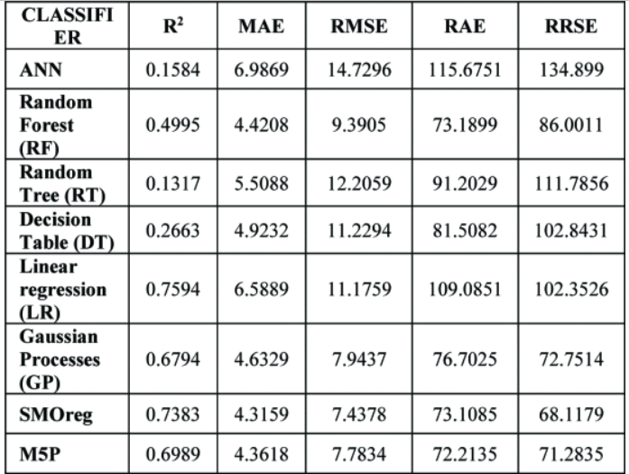
Results
Notes:
SMOreg has performed well and RT has least performance.
Future work-This experiment is based on only class level dataset of KC1 that contains records less than 1000. So it’s better if the paper has tested much larger dataset.

Slide 24
Challenges
Overfitting
Tuning of parameters
Imbalanced Datasets
Fault Pattern
Notes:
ML models outperforms over training set but fails perform over test set. EL based model and k-fold cross validation approach to conquer this problem.
The performance of the existing SFP depends upon the system, and the tunning of parameters/hyperparameters plays a critical role in the performance of the SFP model. There is limited research has done over the tunning of these parameters/hyperparameters.
Imbalance datasets means having few faulty records and more non-faulty records. Most of the software industries don’t reveal their project associated datasets. As most of the datasets are classical datasets, more accessible datasets leads to diverse results.

Slide 25
Conclusion
ML Algorithms are efficient techniques in predicting future software defects.
Combination of two algorithms will be more effective.

Slide 26
Thank You

